Slide 1
Trade Implications of the EU-US TTIP for Neighboring Countries
Alan V. Deardorff
University of Michigan
For presentation at Stanford
February 20, 2014

Slide 2
The Trans-Atlantic Trade and Investment Partnership (TTIP)
Currently being negotiated between the European Union and the United States
  Likely to include:
    Free trade agreement (FTA)
    Removal of “behind the border” barriers to trade and investment

Slide 3
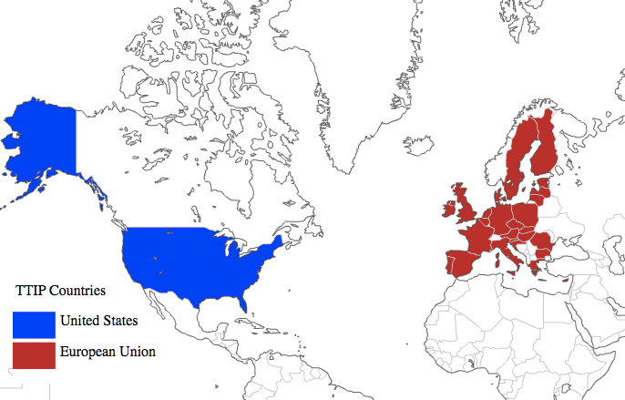
Notes:
Mapping site: http://www.webappers.com/2007/10/11/create-your-own-printable-colored-world-map/

Slide 4
My focus here:
  Trade effects on neighboring countries
  Many of these have FTAs with the EU and/or the US
  How will TTIP enhance or undermine the benefits to them of these arrangements?

Slide 5
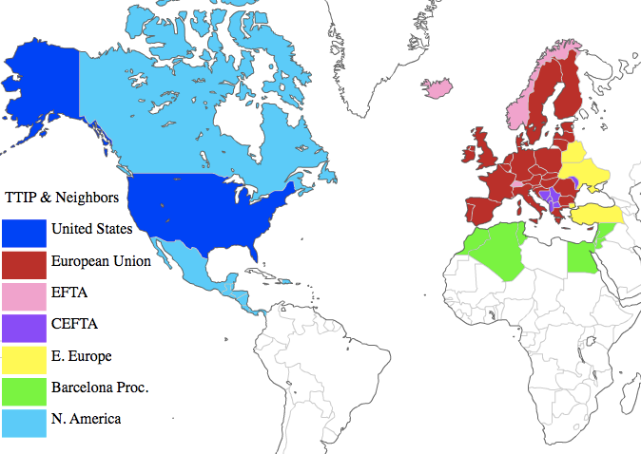
Notes:
Mapping site: http://www.webappers.com/2007/10/11/create-your-own-printable-colored-world-map/

Slide 6
The neighbors are small, and most are very small
  They will matter little, economically to the EU and US
  But they could be important politically

Slide 8
My Issue: How will TTIP affect the trade of its Neighbors?
Why this is of interest:
  TTIP is large, both geographically and economically
  TTIP overlaps with NAFTA and other FTAs
It’s true (and important!) that TTIP will extend well beyond trade and trade barriers (tariffs & NTBs) to include many other issues
  Some trade related
  Some domestic

Slide 9
My Issue: How will TTIP affect the trade of its Neighbors?
But I will focus on trade and on explicit trade barriers such as tariffs?
Why?
  These are probably least important for the EU ad US themselves, as their tariffs are already low
  But they are most important for the neighbors, who will be little affected by things like harmonization of regulations between EU and US

Slide 10
Outline
Description of TTIP
Overlaps of TTIP with other FTAs
Major trading partners of TTIP and its neighbors
Effects of TTIP on neighbors by economy

Slide 11
TTIP
Free Trade Area (FTA)
  Zero tariffs on all goods and services trade between EU and US
  No change in tariffs on imports from outside; thus mostly unequal tariffs
  Rules of Origin (ROOs)

Slide 12
TTIP
Areas that TTIP is set to cover…
  market access for agricultural and industrial goods,
  government procurement,
  investment,
  energy and raw materials,
  regulatory issues,
  sanitary and phytosanitary measures,
  services,
Most important for EU & US
Notes:
http://www.euintheus.org/press-media/eu-and-us-conclude-first-round-of-ttip-negotiations-in-washington/

Slide 13
TTIP
… and more:
  intellectual property rights,
  sustainable development,
  small- and medium-sized enterprises,
  dispute settlement,
  competition,
  customs/trade facilitation,
  state-owned enterprises.

Slide 14
Overlap of TPP with AFTA and other FTAs
TTIP overlap
  EU
    FTAs with EFTA (& European Economic Area on services)
    FTAs with members of the Barcelona Process (N. Africa & Middle East)
    Several FTAs with members of CEFTA (Central Europe Free Trade Area)
  US
    NAFTA (North American Free Trade Area)
    FTAs with several (not all) of Barcelona Process

Slide 15
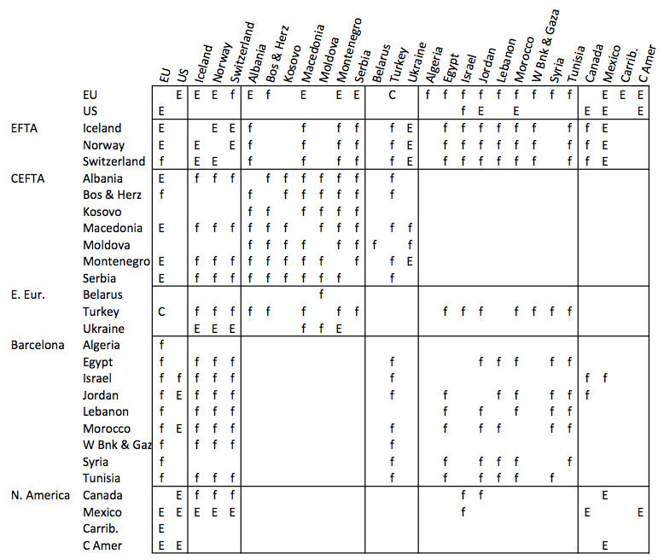
E = Economic Integration Agreement
f = FTA
C = Customs Union
Figure 4: Existing FTAs & EIAs

Slide 16
Overlap of TTIP with other FTAs
Messages:
  EU and US are already heavily linked to their neighbors by existing FTAs:
    Most are both FTAs and Economic Integration Agreements (EIAs) on services .
    Of 26 countries and country groups that I’ve selected as neighbors
      EU has FTA or EIA with all but 6
      US has FTA or EIA with 7

Slide 17
Overlap of TTIP with other FTAs
The Message:
  TTIP should not be understood in the same way that both the original EU and NAFTA were understood, as arrangements among countries that had no other prior arrangements
  TTIP is integration between countries that are already heavily integrated with others

Slide 18
Trade Effects of TTIP
I’ll focus mainly on the largest trade flows
  Top-five partners for exports
  Top-five partners for imports

Slide 19
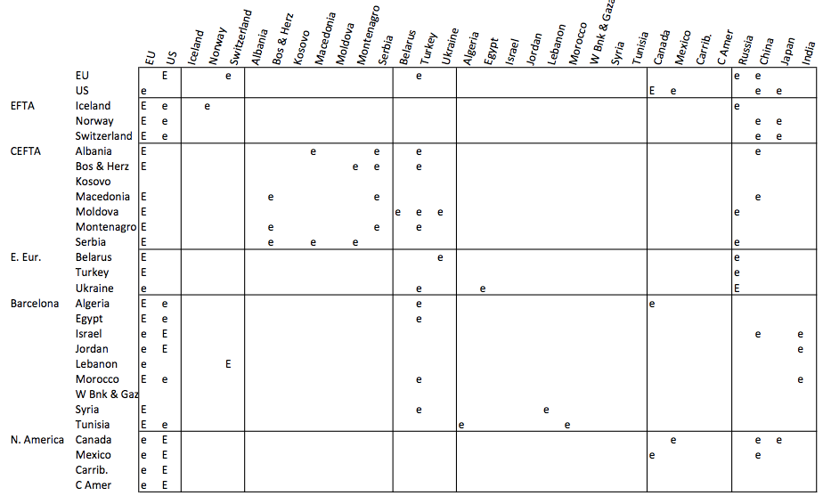
Figure 5
Top Five Destinations for Exports
for EU, US, and Neighboring Economies
Exports from row to column

Slide 20
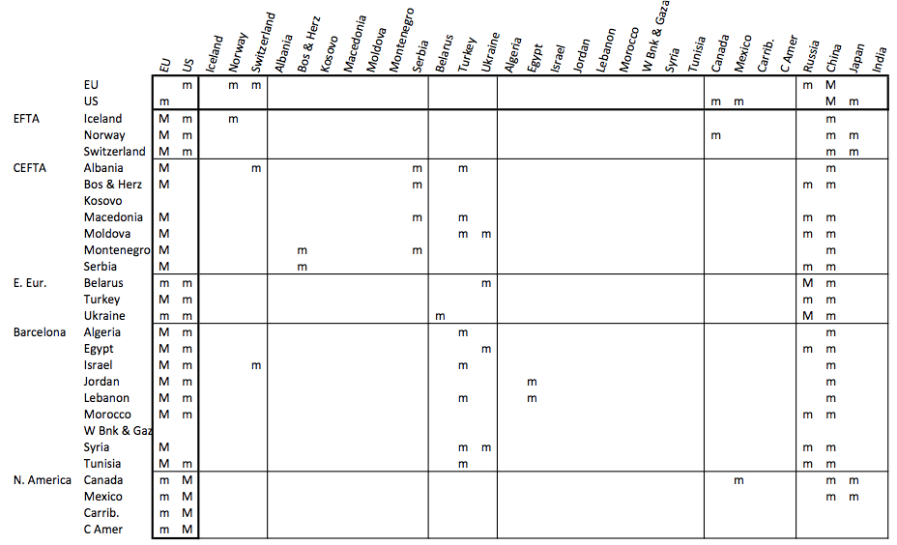
Figure 6
Top Five Origins for Imports
for EU, US, and Neighboring Economies
Imports to row from column

Slide 21
Trade Effects of TTIP
Three main effects
  Trade creation: Import from partner what was previously produced at home
  Trade diversion: Import from partner what was previously imported from 3rd country
  Reversal of trade diversion: Import from new partner what had been diverted to partner in prior FTA (“trade un-diversion”? “trade reversion”? “counter trade diversion”?)

Slide 22
Trade Effects of FTAs
Trade Creation: Import from partner what you previously produced yourself
  Beneficial to partner, which exports
  Beneficial to importing country as a whole
  But harmful to import-competing industry in importing country

Slide 23
Trade Effects of FTAs
Trade Diversion: Import from partner what you previously imported from an outside country
  Harmful to outside country
  Harmless to import-competing industry in importing country (there is none)
  Harmful to importing country as whole, as it pays more for imports
  Beneficial to the partner exporting country

Slide 24
B
A
D
C

Slide 25
(Sample Countries)
(EU)
B
(US)
A
D
(Ukraine)
C
(Egypt)

Slide 26
Trade Diversion
B
Hurts A
Helps C
Hurts B (!)
A
D
C

Slide 27
Trade Effects of FTAs
Additional effect if a member already has an FTA with an outside country:
  Reversal of trade diversion: Imports that were diverted from the new partner by the 1st FTA revert to the new partner with the 2nd FTA
  This is a form of trade diversion
    Harmful to the country diverted from (which had benefited from 1st FTA’s trade diversion)
    But beneficial to the importing country – it gets back to cheap imports

Slide 28
B
A
D
C

Slide 29
(TTIP)
Reversal of Trade Diversion
B
Helps A
Hurts C
Helps B
A
D
More Trade Diversion
C
Helps B
Hurts A
Hurts C (&D)

Slide 30
Trade Effects of TTIP
I now work through the trade effects on individual countries and groups of countries
Discussion is based on the presence and absence of FTAs in Figure 4 covering the major trade flows indicated in Figures 5 & 6

Slide 31
EFTA Countries: Iceland, Norway, Switzerland

Slide 32
EFTA Countries: Iceland, Norway, Switzerland
  Iceland (above) is typical
  These countries share an EIA among themselves and at least FTAs with the EU, but not with US
  They have the EU as their major export destination and import origin
  They also trade significantly with the US

Slide 33
EFTA Countries: Iceland, Norway, Switzerland
  They do not trade significantly with any of the other TTIP neighbors
  Norway and Switzerland do trade significantly with China and Japan, Iceland exports to Russia and imports from China

Slide 34
EFTA Countries: Iceland, Norway, Switzerland
  Their FTAs with the EU will have caused some trade diversion away from the US. This will be reversed by TTIP
    That is economically beneficial for EU
    But painful for industries in EFTA that exported to EU only because of the trade preference vis a vis the US
  They also suffer from conventional trade diversion:
    Their exports to US must now compete with tariff-free exports of the EU

Slide 35
EFTA Countries: Iceland, Norway, Switzerland
  Conclusion: EFTA countries lose from TTIP

Slide 36
CEFTA Countries
  5 of them have FTAs with the EU:
    Albania,
    Bosnia & Herzegovina,
    Macedonia,
    Montenegro,
    Serbia
  2 do not:
    Kosovo
    Moldova
I’ll look at the two groups separately

Slide 37
CEFTA Countries: Albania, Bosnia & Herzegovina, Macedonia, Montenegro, Serbia

Slide 38
CEFTA Countries (5 of them): Albania, Bosnia & Herzegovina, Macedonia, Montenegro, Serbia
  Albania (above) is typical
  These countries share an FTA among themselves and at least FTAs with the EU, but not with US
  They have the EU as their major export destination and import origin
  They do not trade significantly with the US

Slide 39
CEFTA Countries (5 of them): Albania, Bosnia & Herzegovina, Macedonia, Montenegro, Serbia
  Some trade significantly with others in the group, as well as with Turkey.
  But they don’t trade much with other TTIP neighbors.
  They do trade significantly with China and some of them import significantly from Russia

Slide 40
CEFTA Countries (5 of them): Albania, Bosnia & Herzegovina, Macedonia, Montenegro, Serbia
  Because of their FTAs with the EU and not with the US, the effects of TTIP on them will be similar to those on the EFTA countries, discussed above.
  Conclusion: They will be hurt by TTIP

Slide 41
CEFTA Countries: Kosovo, Moldova
I don’t have trade data for Kosovo.

Slide 42
CEFTA Countries (2 of them): Kosovo, Moldova (I don’t have trade data for Kosovo)
  These two countries have FTA only with the other CEFTA countries, but not with EU or US
  Their trade (at least that of Moldova) is largest with the EU, but significant also with E. Europe and Russia
  As complete outsiders of TTIP who depend greatly on trade with the EU, they will lose due to trade diversion.

Slide 43
Eastern Europe: Belarus, Turkey, Ukraine

Slide 44
Eastern Europe: Belarus, Ukraine
  These two countries export significantly to the EU and import also from the US. But their trade otherwise is with each other and with Russia
  They are in hardly any FTAs
  As outsiders to TTIP with export interest in the EU, they will lose from trade diversion

Slide 45
Turkey
  Turkey is a very special case, as it has a customs union with the EU and therefore, of necessity, shares the EU’s FTAs
  With its EU customs union, Turkey shares the EU’s external tariffs, which presumably will include its zero tariffs on imports from the US under TTIP
  But Turkey is not, currently, a party to the TTIP negotiations and therefore will not benefit from reduced US tariffs on its exports

Slide 46
Turkey
  Turkey will
    Gain from reversal of its own trade diversion favoring the EU
    Lose from reversal of the EU’s trade diversion favoring Turkey
    Since its exporters will continue to face US tariffs, it will also lose from new trade diversion, as the US buys from the EU instead of from Turkey
  Conclusion: Turkey is most likely to lose from TTIP
  It could gain if it were included as part of it.

Slide 47
Barcelona Process Countries:
  All have FTAs with the EU
  5 have no trade agreement with the US
    Algeria,
    Egypt,
    Lebanon,
    Syria,
    Tunisia
  3 do have either FTA or EIA with US:
    Israel,
    Jordan,
    Morocco
  (I’m ignoring the West Bank & Gaza, for which I have no trade data)
I’ll look at the two groups separately

Slide 48
Barcelona Process Countries: Algeria, Egypt, Lebanon, Syria, Tunisia

Slide 49
Algeria, Egypt, Lebanon, Syria, Tunisia
  Egypt (above) is somewhat representative of these 5 countries
  They have FTAs with the EU but not with the US
  They trade most with the EU, but also significantly with the US
  Like others considered above, they stand to lose from TTIP due to trade diversion

Slide 50
Barcelona Process Countries: Israel, Jordan, Morocco

Slide 51
Israel, Jordan, and Morocco
  These are unique among the countries considered so far, in that they have FTAs with both the EU and US
  To the extent that their significant exports to both were diverted from direct EU-US trade, this advantage will be lost with TTIP
  They stand to lose more than most

Slide 52
The NAFTA Countries

Slide 53
Canada and Mexico
  The only notable difference between these two is the absence of an FTA between the EU and Canada, and this has now been announced
  Thus, like Israel, etc. above, these countries have FTAs with both the EU and the US, and they stand to lose when those gain equally preferential access to the other.

Slide 54
A Final Word on Rules of Origin
FTAs (unlike customs unions) necessarily have rules of origin
With a complex web of FTAs, expanding with TTIP, an important issue is “cumulation of ROOs”
  Do imported inputs from third countries count as originating within the FTA?

Slide 55
A Final Word on Rules of Origin
The US favors “bilateral cumulation,” under which the answer is NO.
  This limits the extent to which the FTA liberalizes trade, since much trade may still be subject to tariffs
  Worse, firms may switch to higher cost inputs within the FTA in order to qualify under the ROO
  This can mean that a web of FTAs can be worse than none

Slide 56
A Final Word on Rules of Origin
The EU uses “diagonal cumulation” for the countries of the Barcelona Process.
  Thus products assembled in, say, Morocco with inputs from, say, Tunisia will still qualify for tariff-free entry into the EU
Were this extended to all of the EU and US FTA partners, the effects of TTIP would be better all around.

Slide 57
Conclusion
Trade effects of TTIP on the neighbor economies will be mostly that they lose from either
  New trade diversion, or
  Reversal of previous trade diversion that was in their favor

Slide 58
Appendix: Country Data

